Slide 1

Stroke Smart Education and Champion Pledge Certificate Information

Slide 2
Audience: Anybody!
Duration: 10-15 minutes
The purpose of this presentation is to provide guidance on Stroke Smart education and how to offer the opportunity to take the Stroke Smart Champion Pledge.

Slide 3
Gather Materials in Advance
Access Stroke Smart Materials at (insert website) and have printed copies available
Have technology needed to show Virginia's 3 minute "How to Spot a Stroke" video.
Print Stroke Smart Champion Pledge certificates in color, enough for each participant
Pens or markers

Slide 4
Step 1. Provide Simple Stroke Smart Education
Open: Did you know, you can spot a stroke, stop a stroke and save a life? And you can teach others!
1
Emphasize key messages:
2
It’s usually bystanders who call 911. That’s you!
Educating others protects you and the community.
Watch the “How to Spot a Stroke” 3-minute video.
3
Review the acronym BEFAST as a group.
4
BEFAST: Balance, Eyes, Facial droop, Arm weakness, Speech problems, Time to call 9-1-1.
Reference the Stroke Smart materials (wallet card, poster, etc.) that you will be giving out.

Slide 5
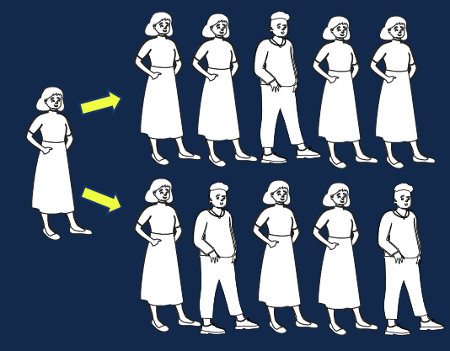
Step 2. Offer the Stroke Smart Champion Pledge
“Would you like to take the Stroke Champion Pledge?”
Are you committed to teaching others to be Stroke Smart?
Think about:
  Who can you teach about Stroke Smart?
  Where will you teach them?
  How will you teach them?
•Count it out: How many people can you teach?
20 stroke champions can become 100- OR MORE!

Slide 6
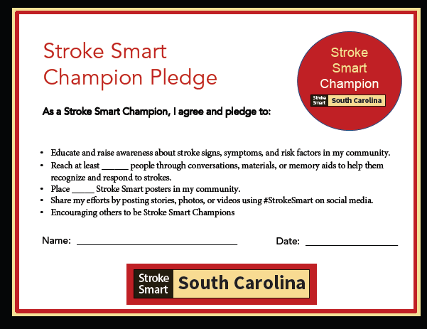
Step 3. Pass out and Complete Pledge Forms
Pass out certificates printed in color.
Give people time to fill it out.

Slide 7
Step 4. (final step!) Distribute Memory Aids
Give out enough to each Pledge Champion to reach the number on their certificate:
Wallet cards, Magnets and/or Posters
•Take a group photo (if appropriate).
You may need a photo release!

Slide 8
For more information about Stroke Smart, please email stroke@dph.sc.gov

